Slide 1

News, January 2015

Slide 2
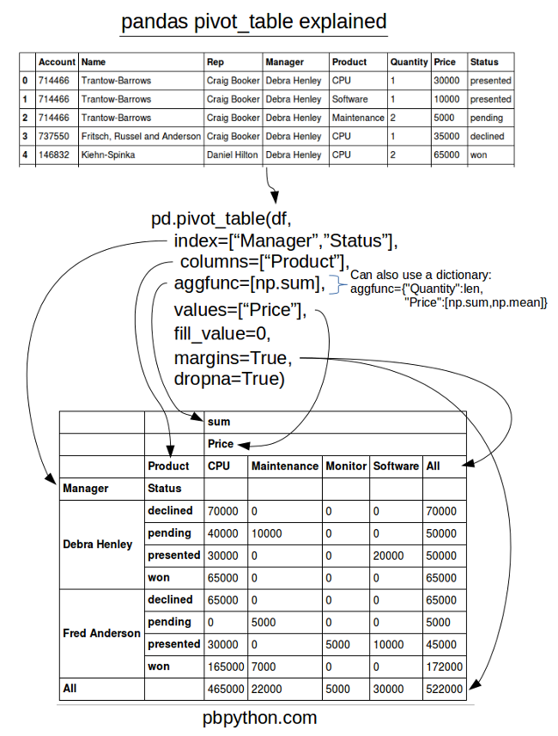
Pandas pivot table explained
http://pbpython.com/pandas-pivot-table-explained.html

Slide 3
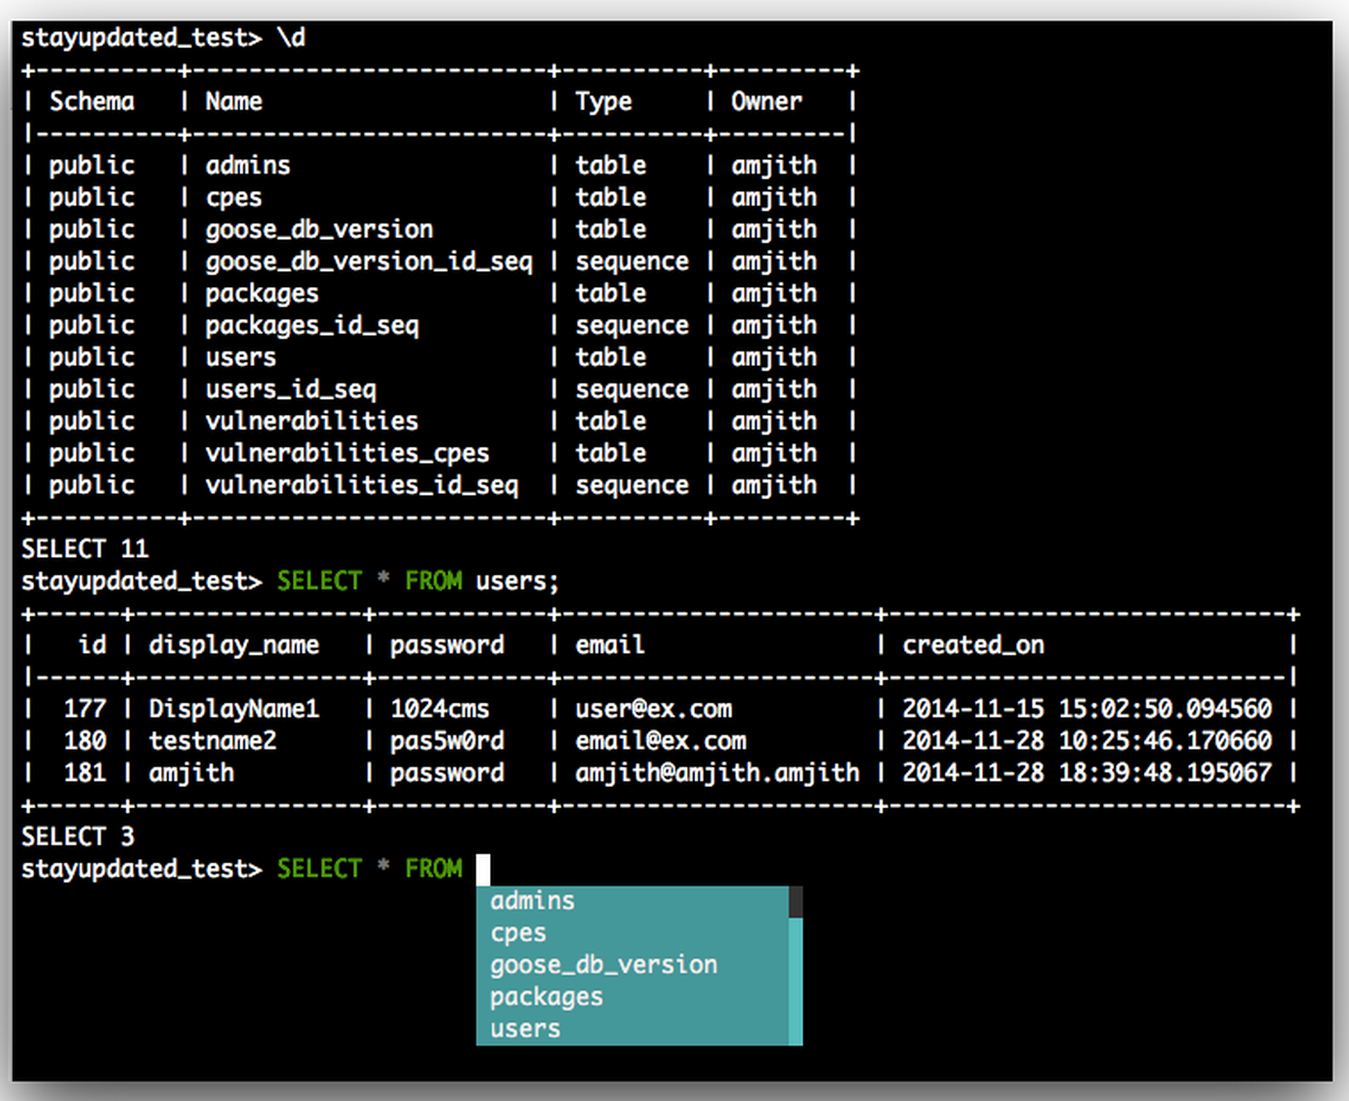
pgcli – autocomplete for psql
github.com/amjith/pgcli

Slide 4

Python 2.7.9rc1 - released
Backporting to Python 3 features.
SSL module backported and in sync.
https://docs.python.org/dev/whatsnew/2.7.html

Slide 5
Heroic show of loyalty!
Christmas day: 2 members
New years day: 4 members

Slide 6
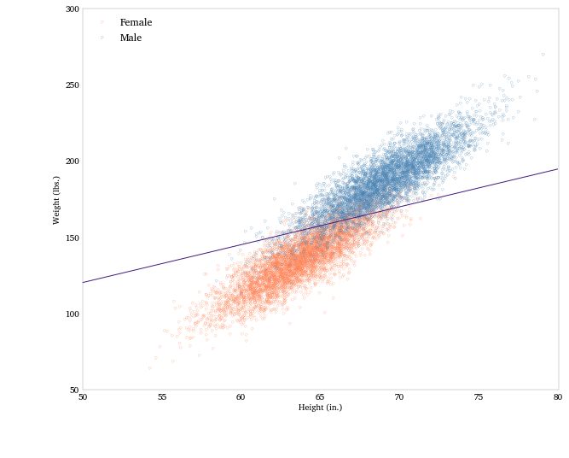
POTM: statsmodels
Extensive package of descriptive statistics, plotting functions and results
Pandas has made statsmodels awesome.
github.com/statsmodels/statsmodels.git

Slide 7
PyData London 2015!!!!
Updates

